Slide 1
3D Remote Viewing Platform Real-time HDR Imaging
Scott Rapson
Dr Russell Brinkworth
Daniel Griffiths

Slide 2
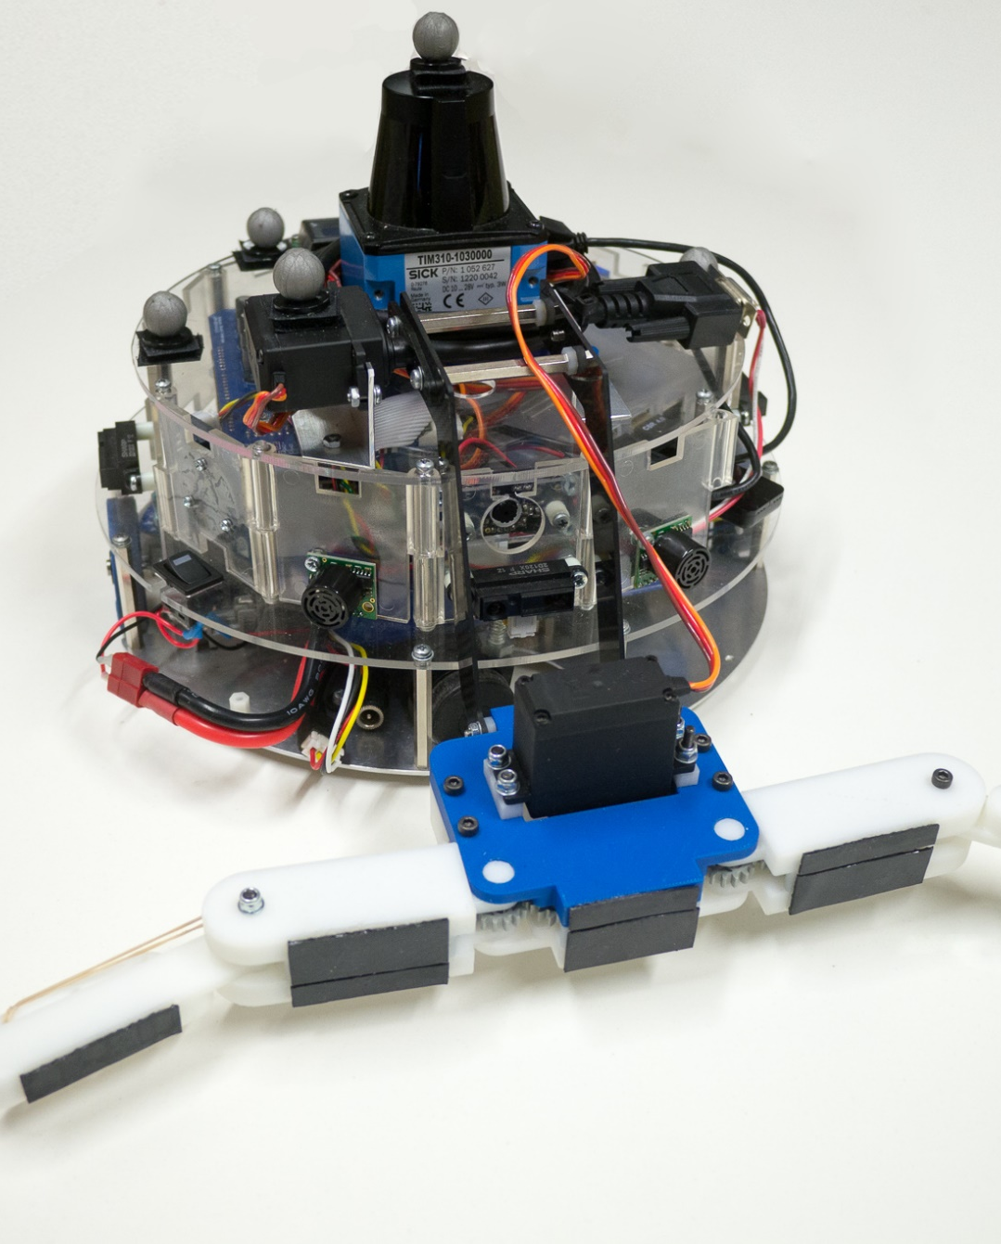
Contents
Background Info
Project Motivation
Objectives
Hardware Selection
Pipeline Explanation
Current Progress
Remaining Work
Jack Baker | 2

Slide 3
Why does dynamic range matter?

Slide 4
Colour Space and Quantization
Conversion between linear and non-linear colour spaces demonstrates issues with banding in shadow areas.
The following example shows the effect of quantization between linear and
Red: 8bit -> 5 bits
Green: 8bit -> 6 bits
Blue: 8bit -> 5 bits
Vertical white line shows the intensity midpoint in the range
Checkerboard is a constant 50% reference
4
Notes:
As well as writing some performance test shaders, I’ve written several standalone shaders which explore different elements of the imaging process.
Uncharted 3 - ((x*(0.15*x+0.10*0.50)+0.20*0.02)/(x*(0.15*x+0.50)+0.20*0.30))-0.02/0.30;

Slide 5
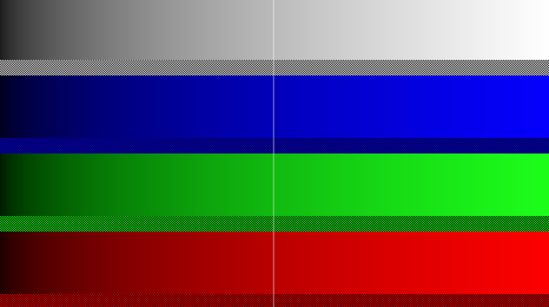
Linear, 24bit colour space

Slide 6
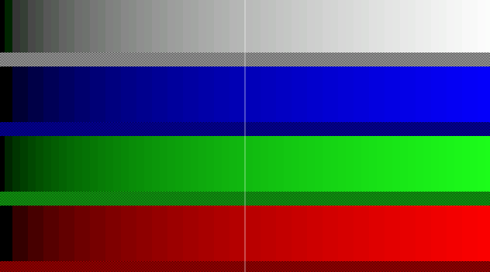
Linear, 16bit colour space

Slide 7

Gamma, 24bit colour space

Slide 8
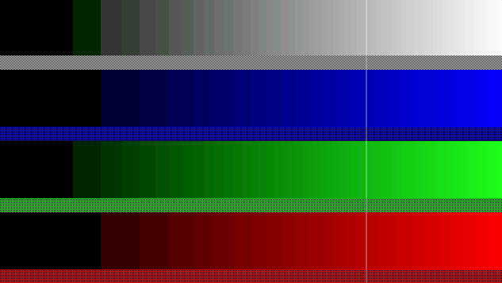
Gamma, 16bit colour space

Slide 9
Existing HDR Approaches
- Varied exposures over time
- High frame rates (S. Kang et al)
- Multiple Sensors and Beam Splitters (M. Tocci et al)
- Neutral Density Pixel Filters
Custom Sensor Topology
Pixel Binning

Slide 10
Project Motivation
HDR video streams vastly improve outdoor imaging performance
Greater scene detail for computer vision
Allows for ‘natural’ imaging in robotic telepresence applications (eg HMD)
Current online approaches are somewhat expensive and usually require esoteric hardware or low level control of camera hardware.
Existing offline approaches have low temporal resolution

Slide 11
Objectives
System allows the user to:
View a real-time video stream of a typical outdoor environment without excessive clipping of highlight or shadow details,
Interpret and process the wide range of luminances and prepare output data for human use,
Form factor suitable for use on untethered mobile platforms.
11

Slide 12
Proposed System
To meet the requirements in a cost effective manner, the following system is proposed:
Off-the-shelf single board computing platform to meet packaging requirements and cost constraints.
Multiple commodity webcams to reduce reliance on high FPS cameras or custom optics/sensors.
GPU based processing pipeline to minimise latency and promote scalability.
12

Slide 13
Hardware Selection
The single board computer should have a minimal footprint and relatively low power consumption to allow for use on small UGV and RPA platforms.
Sufficient I/O & bus capabilities to allow for simultaneous camera access,
OpenGL capable GPU,
Small form factor
Low power consumption (~10-30W)
Reasonable cost to fit within budget constraints ( < $250AUD )
13

Slide 14
ODroid XU4
4+4 core CPU, 2GB RAM
Capable Mali-T628 GPU
Gigabit Ethernet & USB3
$75USD
Software compatible with the XU3, used on existing UniSA AMS ‘MechBot’ rovers.
14

Slide 15
Camera Selection
The ODroid branded webcams were chosen
Enticing performance for a low price
Small footprint when removed from housing
Tested by the University ‘MechBot’ platforms
15

Slide 16
HDR Construction
The construction process is broken down into the key steps:
Sample data from camera textures
Apply hardcoded transforms for frame alignment
Colour space conversions and camera curve corrections
Pixels are weighted based on their corrected luma value
Each pixel is summed with the other LDR images against its weight
16
Notes:
Camera textures are sampled in a vertex shader as required by the OpenGL pipeline, and we apply some static transforms between frames to compensate for mechanical mounting issues resulting in frame offsets
The LDR images have camera curve compensation applied to correct for the differing response between colour channels at different intensities
The weight of the pixel in each LDR image is calculated to attenuate the contribution of over or under exposed pixels
Luma values are summed based on their weights, giving a high dynamic range image

Slide 17
HDR Deconstruction to LDR
We need to reduce the depth of the image for display:
HDR output is reduced to a lower dynamic range (global).
- Fitted to a curve to compress relevant information (tonemapping)
- Different curves for ‘pretty’ images, fine detail emphasis, computer vision
Local tonemapping can be applied based on neighboring features
Additional adjustments to overall brightness and saturation.
The image is now suitable for display to the user
17

Slide 18
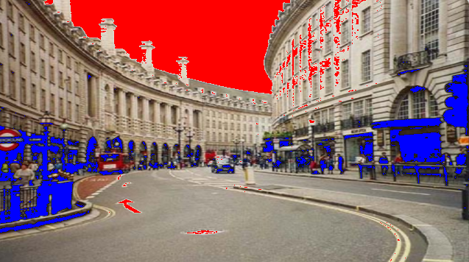
Software Progress
Vertex shader: Read camera textures from hardware for use with fragment shaders.
Prototype fragment shaders:
Clipping detection (pictured)
LDR pixel averaging
Tone Mapping Tests - Linear vs Reinhard Curve
- Sigmoidal contrast curves
Quantitization tests to compare linear and log colour spaces
18
Notes:
The bulk of progress has been made on the software side using open licence test images and video in order to quickly develop suitable shaders.
As well as writing some performance test shaders, I’ve written several standalone shaders which explore different elements of the imaging process.
The first test used a curve based clipping detection to identify areas to substitute directly from the other LDR frames. This demonstrates the most basic form of a expanded luminance range but features artifacts and has poor transitions between the data sets. This data does not represent an increase in bit depth, so the colour space has not improved.
Pixel averaging of multiple frames has been achieved, and weighting values are stored in the alpha channel of each image
The more time consuming shaders have evaluated the effects of contrast curves in order to compress the HDR image for display.
Uncharted 3 - ((x*(0.15*x+0.10*0.50)+0.20*0.02)/(x*(0.15*x+0.50)+0.20*0.30))-0.02/0.30;

Slide 19
Issues
Ordered hardware has not arrived, however substitutes have been aqquired
19
Notes:
As well as writing some performance test shaders, I’ve written several standalone shaders which explore different elements of the imaging process.
Uncharted 3 - ((x*(0.15*x+0.10*0.50)+0.20*0.02)/(x*(0.15*x+0.50)+0.20*0.30))-0.02/0.30;

Slide 20
Remaining work
Migrate shaders over to Odroid XU4 once received
Simultaneously read 3 USB webcams.
Complex deformation in vertex shader to reduce parallax artifacts
Final enclosure design and camera mounts
Integration with GStreamer for integration with the stereoscopic headmounted telepresence system developed by Christopher Barr
Expansion Task: Auto exposure adjustment based on clipping pixels
20
Notes:
Shaders have been tested on the odroid xu3

Slide 21
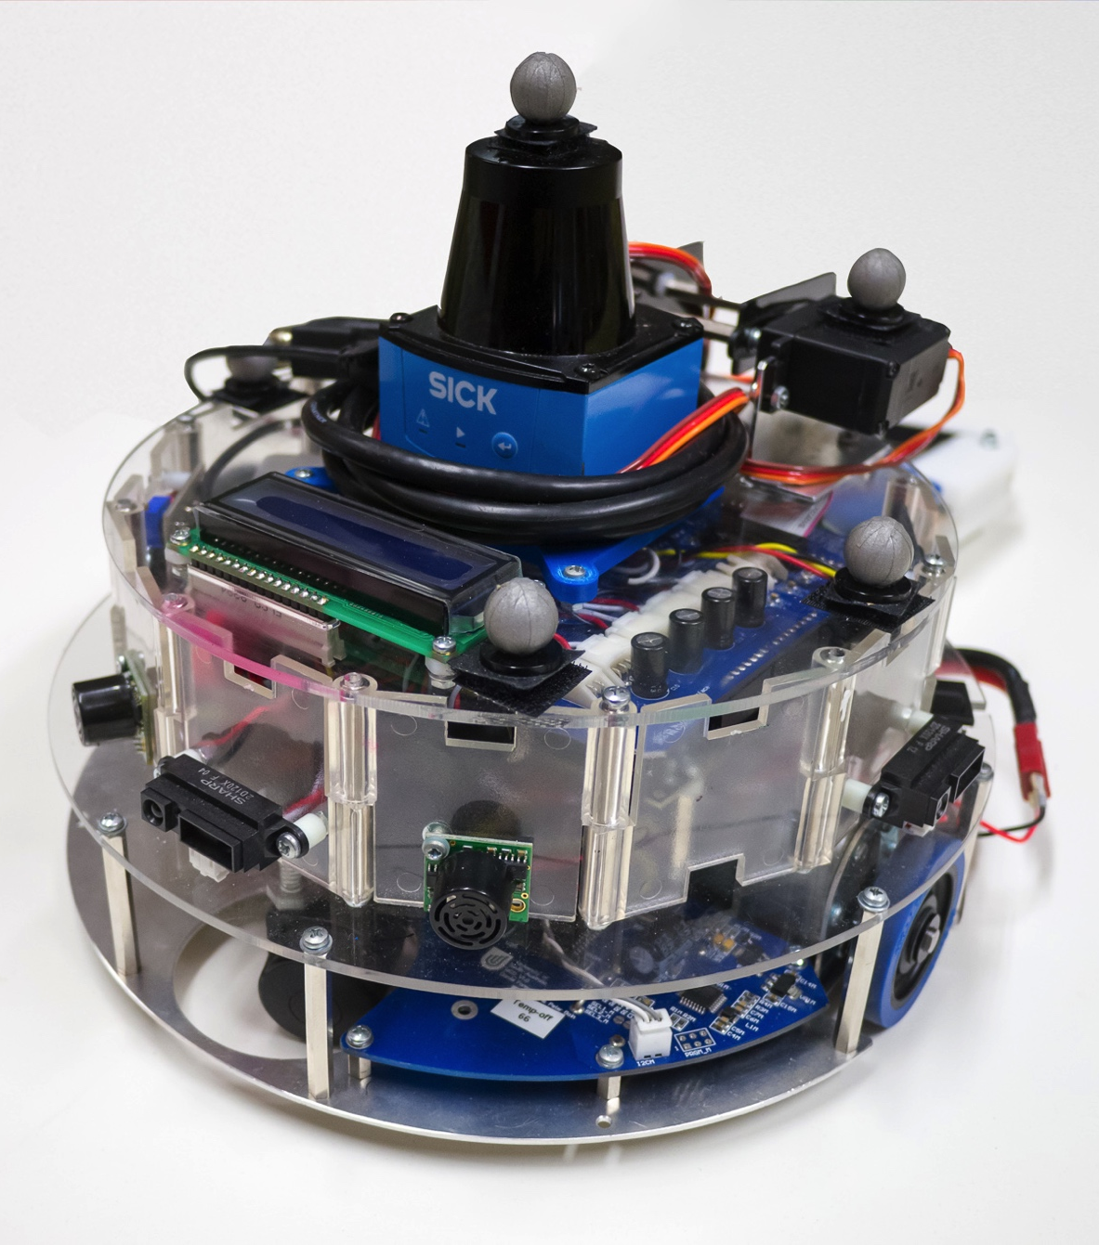
Summary
Proposed system uses GPU approach with multiple cameras for HDR output
Hardware has been selected
Critical shaders have been written and tested on hardware
Scott Rapson | 21

Slide 22
Thank You
Questions?

